Slide 1

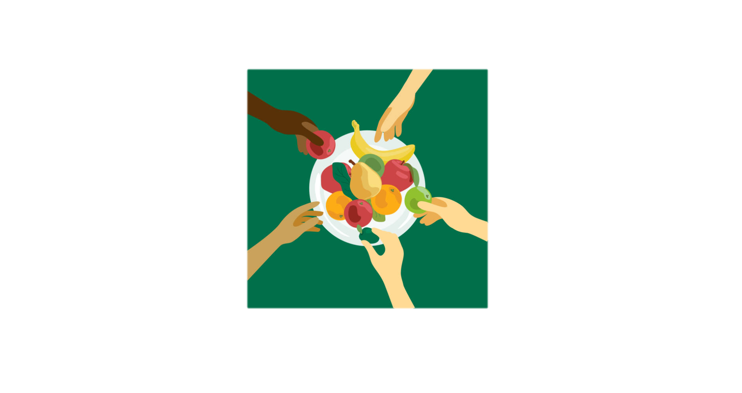
Malla Reddy College of Engineering and Technology
Department of Information Technology
SHAREPLATE:
“Give a meal today !”
Batch-No:08
22N31A3333 – M VAMSHI YADAV
22N31A3345 – P HARISH YADAV
22N31A3305 – B VAMSHI VARDHAN

Slide 2
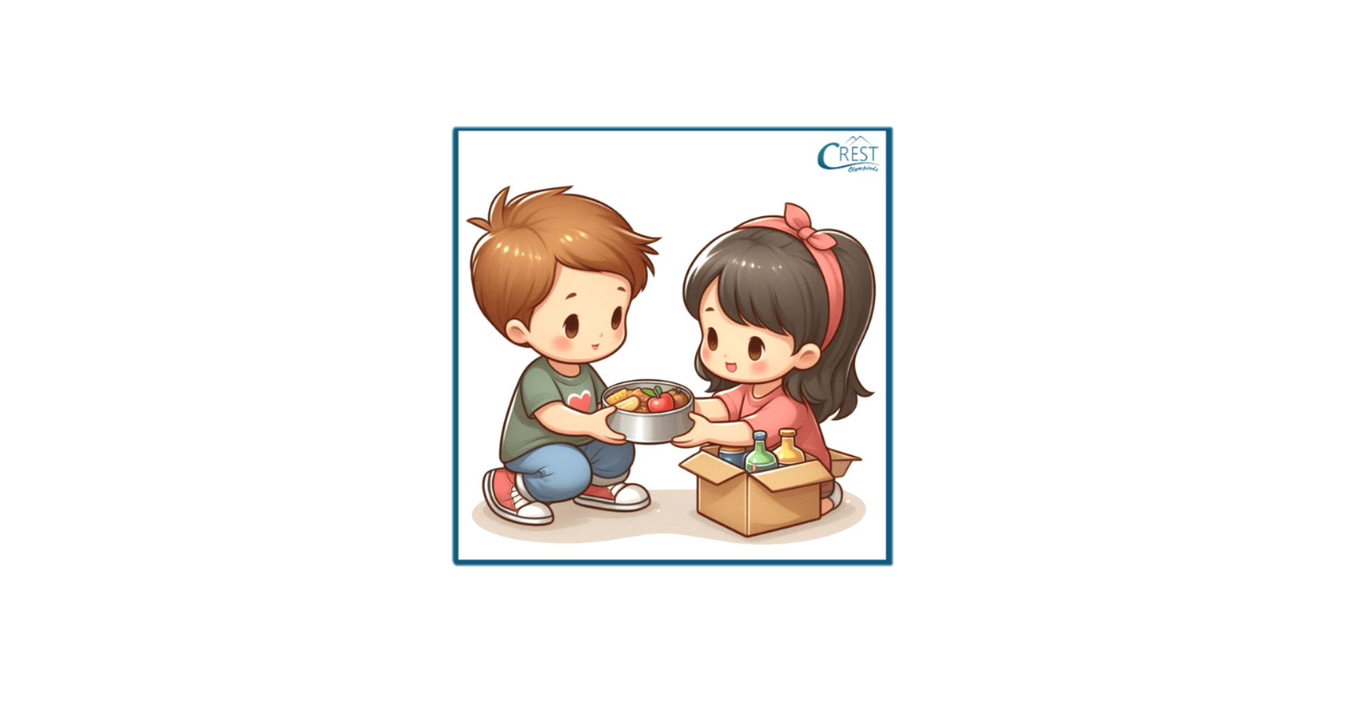
Agenda
Introduction
Existing System
Proposed System
System Requirements
Software Requirements
Hardware Requirements
Application Description
Conclusion

Slide 3
Introduction
In a world where food waste and hunger coexist, SharePlate acts as a vital link connecting surplus food with those in need. This innovative web-based platform, developed using HTML, CSS, and MongoDB, empowers individuals to donate leftover food by easily listing essential details and mapping its precise location. Those in need can effortlessly search for specific food items by name and access comprehensive details, including exact locations, through an integrated map feature. By leveraging a community-driven approach to food distribution, SharePlate aims to significantly reduce food waste and ensure that surplus food reaches those who need it most. The platform is designed to provide a lightweight and accessible user experience by minimizing the use of complex JavaScript functionalities, making it accessible to a broad audience and fostering a culture of sharing and sustainability.

Slide 4
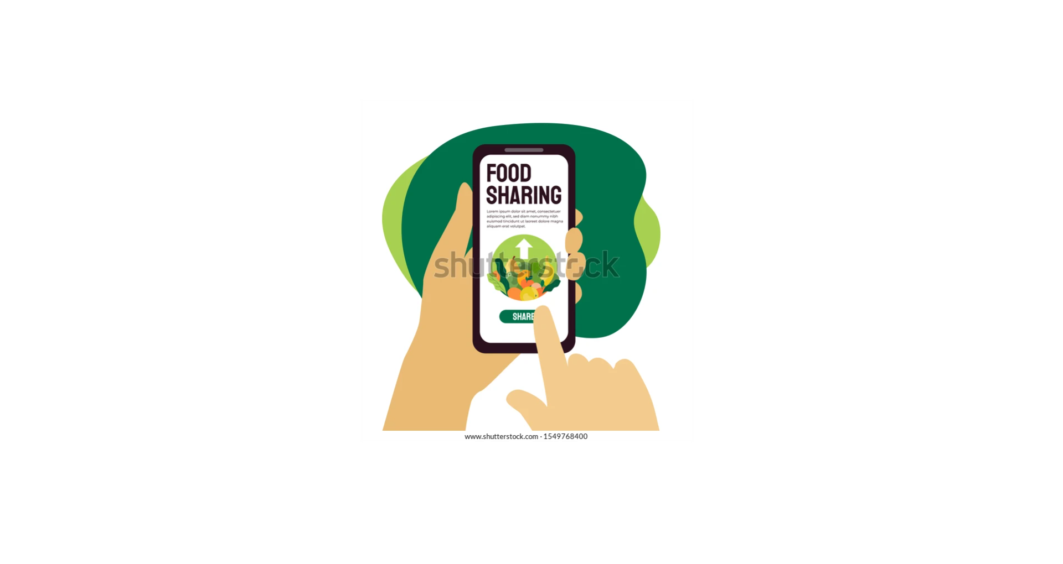
Existing System
In the current landscape, food donation and distribution often rely on physical locations such as food banks and shelters, which may have limited reach and accessibility. Existing systems may not efficiently match available food with those in need due to logistical challenges and lack of technology integration. Key limitations include:
Limited Reach: Traditional food banks may not cover all areas, leaving some individuals without access to donated food.

Slide 5
Inefficient Matching: Difficulty in connecting donors and recipients quickly and effectively.
Manual Processes: Heavy reliance on manual processes for food distribution, leading to inefficiencies.
Food Waste: Excess food often goes to waste due to a lack of timely distribution channels.

Slide 6
Proposed System
Enhanced Accessibility: The online platform allows users to list and find food from anywhere, increasing the reach and impact of donations.
Efficient Matching: Advanced search capabilities and notifications ensure that food reaches recipients quickly and efficiently.
Technology Integration: Utilizes modern web technologies and map integration for a seamless user experience.
Community Engagement: Encourages community participation in reducing food waste and supporting those in need.

Slide 7

System Requirements
Operating System : Windows 11
IDE : VS Code
Database :Mongo DB
Frontend language : HTML,CSS,JAVA SCRIPT
Backend languages : Nodejs

Slide 8
Hardware Requirements
PROCESSOR : Intel core i5
RAM : 4 GB
HARD DISK : 512 GB

Slide 9
Application Description
SharePlate is an innovative web platform designed to bridge the gap between food surplus and hunger by connecting individuals and businesses with excess food to those in need. The application facilitates the easy donation and distribution of leftover food, helping to reduce waste and promote food security in communities.
Purpose: SharePlate connects individuals and businesses with surplus food to those in need, reducing food waste and promoting food security.
User-Friendly Interface: The platform offers an intuitive, easy-to-navigate design accessible on all devices, catering to users of all ages.
Food Donation: Donors can list leftover food items by providing details such as type, quantity, expiration date, and location.

Slide 10
Food Search: Recipients can search for available food by name, category, or location, using an integrated map feature to find nearby food sources.
Map Integration: The application uses mapping services to display food locations and provide directions, enhancing the user experience.
Community Engagement: Encourages community-driven solutions to food waste and hunger, fostering a culture of sharing and sustainability.
Security and Privacy: Ensures secure authentication and data protection, safeguarding user information.
Impact: Aims to reduce food waste, improve food security, and promote environmental sustainability through efficient food redistribution.

Slide 11
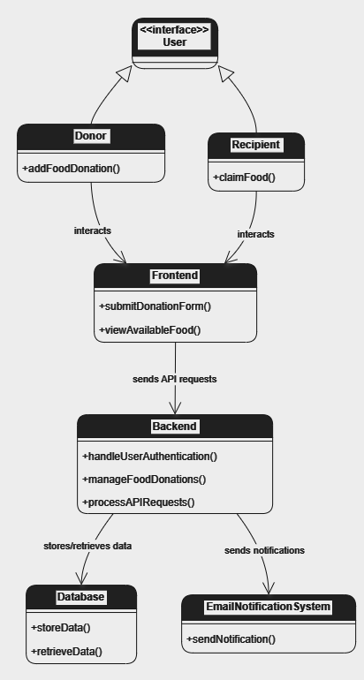
ARCHITECTURE

Slide 12
METHODOLOGY
This section explains the systematic approach taken to develop the platform for donating and receiving surplus food. The methodology is divided into several phases:
Requirement Analysis : Identified the key stakeholders (donors, receivers, and platform administrators). Defined the main features and functionalities needed, such as user registration, food listing, donation tracking, and notifications. Conducted user research to understand the pain points and expectations of both donors and recipients.

Slide 13
Design and Planning :
Frontend Design: Designed an intuitive, user-friendly interface to ensure that the platform is accessible to a broad audience. Wireframes and UI mockups were created using tools like Figma.
Backend Architecture: Structured the backend to handle user authentication, real-time food listing updates, and request processing efficiently. Selected Express.js for server-side logic and MongoDB for the database to store food, user, and transaction data.
Database Design: Choose a NoSQL database (MongoDB) to allow for flexibility in data structure. Collections were created for users, food items, and donation transactions.

Slide 14
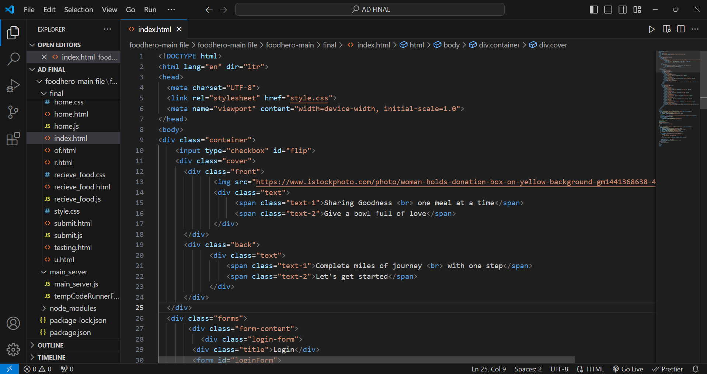
IMPLEMENTATION

Slide 16
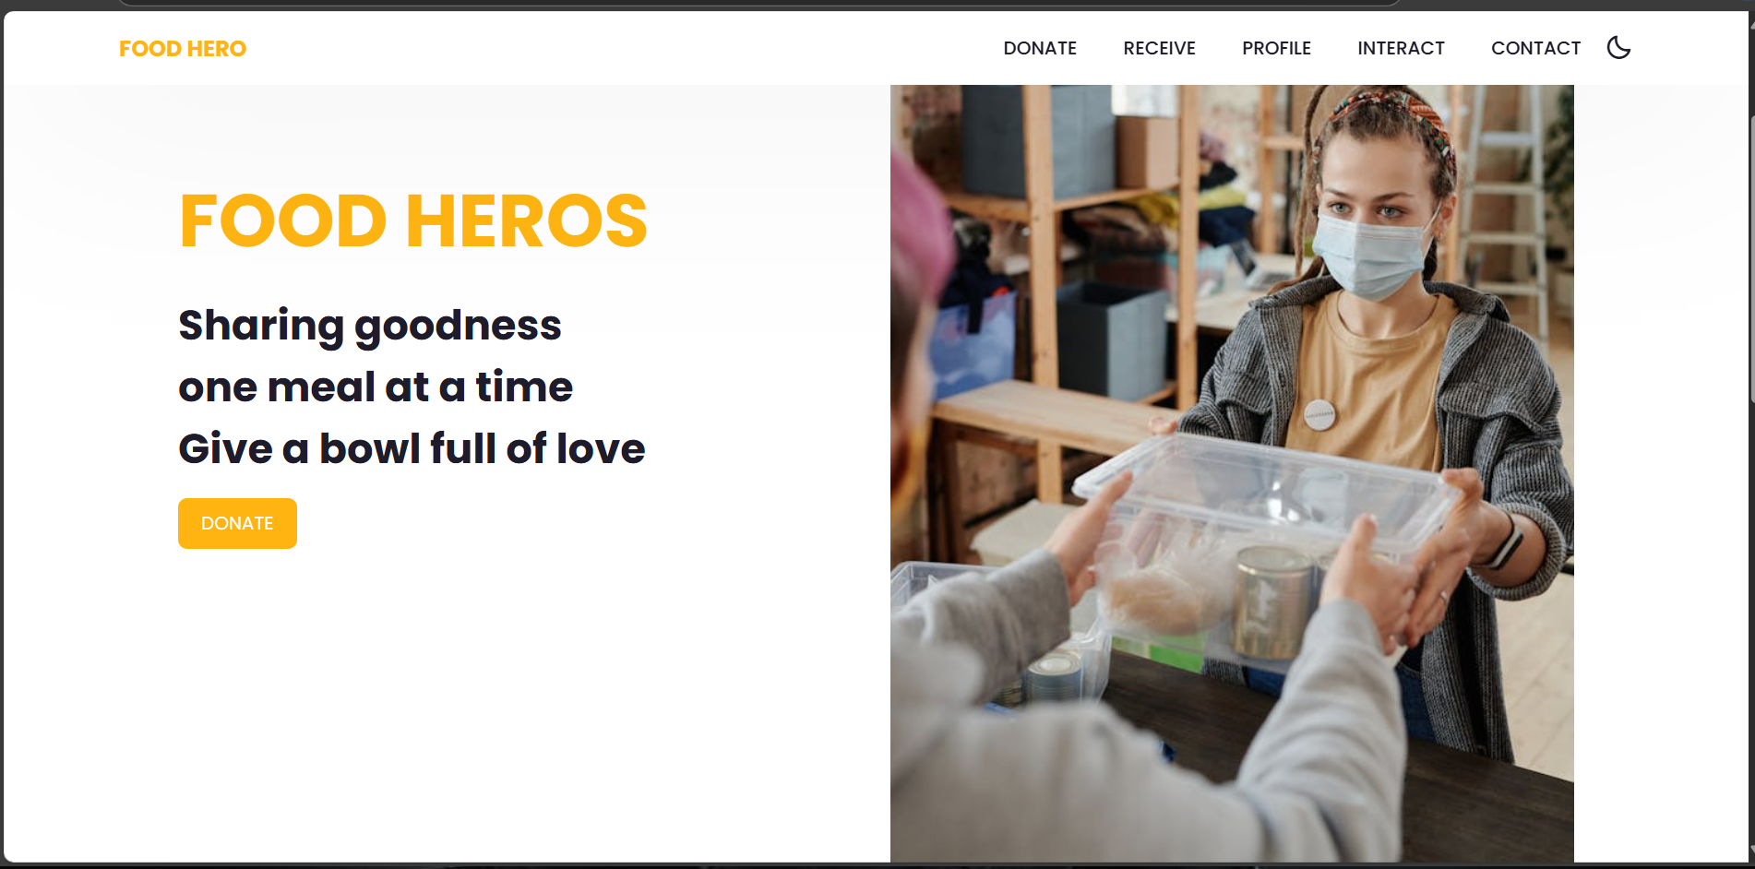
OUTPUT SCREENS

Slide 17
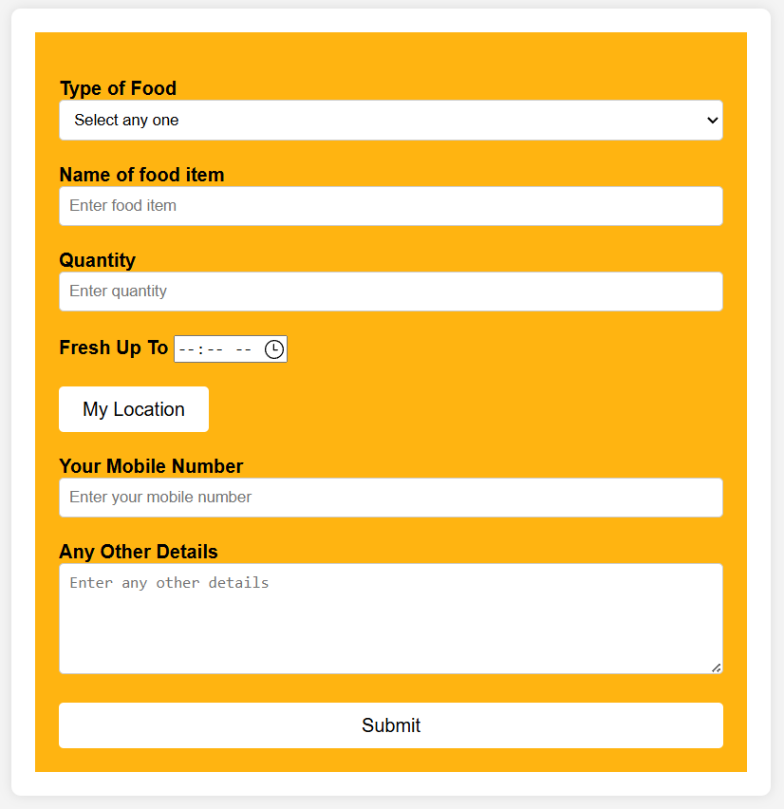

Slide 18
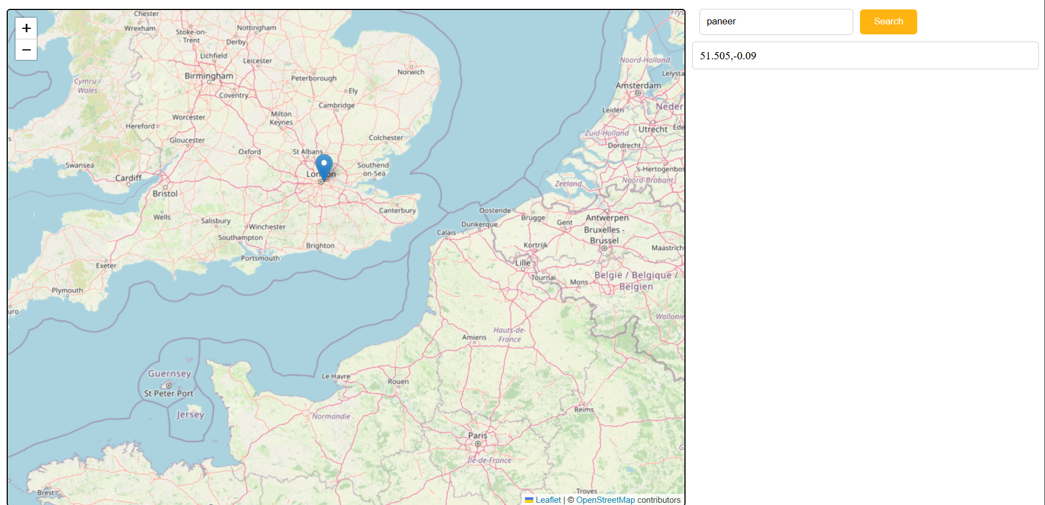

Slide 19
Conclusion
SharePlate is an innovative platform to reduce food waste and combat hunger by connecting those with surplus food to those in need. It promotes food security and environmental sustainability through its user-friendly design and advanced features, encouraging active participation from individuals and businesses. By leveraging technology and community-driven solutions, SharePlate seeks to transform food distribution and foster a culture of sharing and responsibility. As the platform expands, it aims to create a significant positive impact, envisioning a future where surplus food is shared, ensuring everyone has access to necessary nourishment. Join SharePlate to make a difference—one plate at a time.

